Slide 1

Building
Language & Cultural Connections
CS377E Global Grand Challenges - Team 4

Slide 2
POV 1
We met Klint, a graduate student from the U.S. who enjoys traveling. We were amazed to realize that though he has a really strong desire to connect with people from different cultures, he has no self-discipline to learn the languages that would help him build those connections. It would be game-changing if we could help Klint build deeper connections while traveling.

Slide 3
POV 2
We met David, a university lecturer from Ireland who has been working in China for the past 7 years. We were amazed to realize that his social life and community is limited to an English-speaking minority because of his limited Chinese proficiency. It would be game-changing to expand his social boundaries and opportunities to include non-English-speakers.

Slide 4
POV 3
We met Zixuan, a 17-year-old from China attending a pre-college program in the US. We were surprised to realize that she doesn’t want to talk to people in English because making mistakes makes her feel stupid. It would be game-changing to help her embrace mistakes as positive and good for growth.

Slide 5

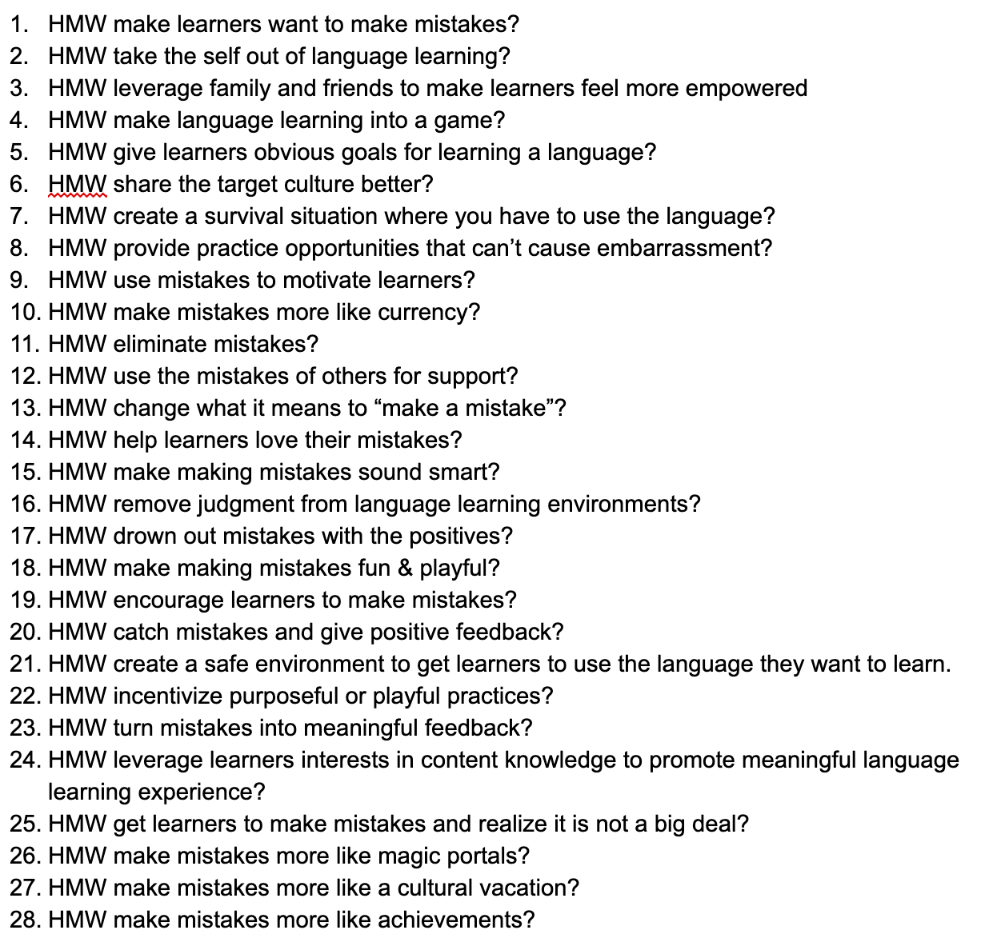
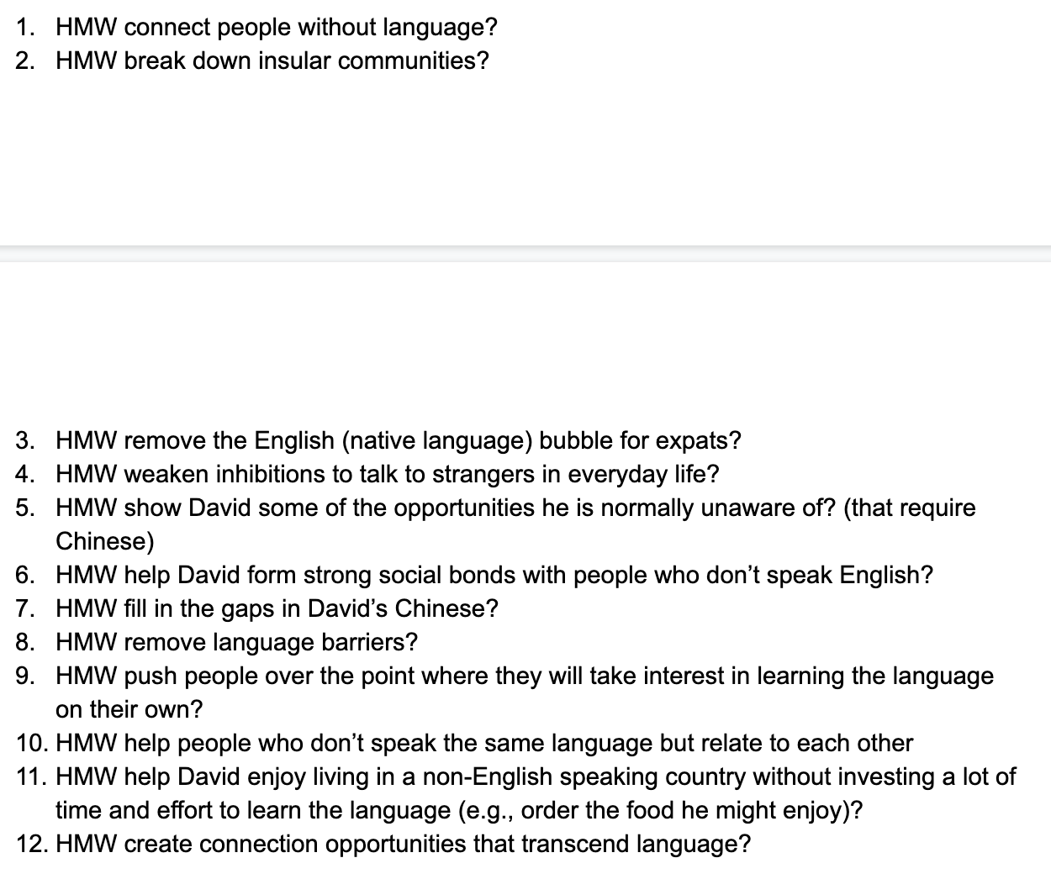
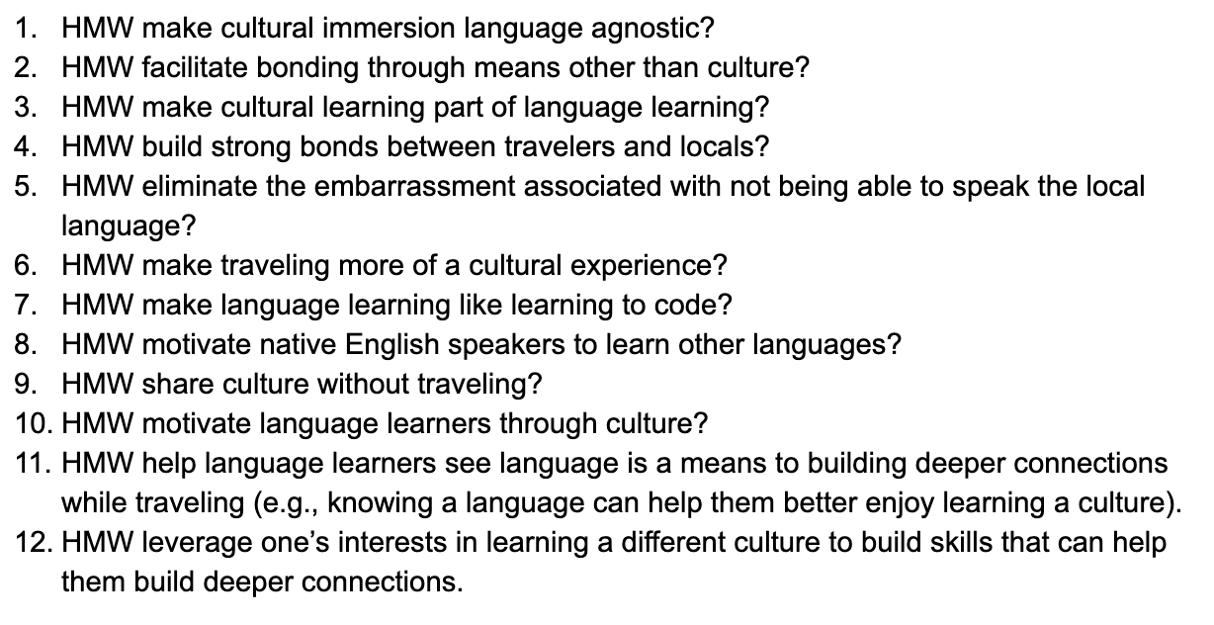
53 HMWs
8 Categories
THEMES: MISTAKES ARE GOOD, PSYCHOLOGICAL SAFETY (NOT EMBARRASSED), ACTUALLY, WE DON’T NEED LANGUAGE, MISCELLANEOUS, MISTAKES ARE NOT BAD, FEEDBACK MOTIVATION, BUILDING COMMUNITY & CONNECTIONS

Slide 6
MISTAKES ARE GOOD
HMWs
HMW make mistakes more like achievements?
HMW make mistakes more like currency?
HMW make making mistakes fun & playful?
HMW encourage learners to make mistakes?
HMW make mistakes more like magic portals?
HMW help learners love their mistakes?
HMW make learners want to make mistakes?
Notes:
Reorganizing it, top 3 groups of HMW are -

Slide 7
ACTUALLY, WE DON’T NEED LANGUAGE
[dark horse]
HMWs
HMW connect people without language?
HMW help David enjoy living in a non-English speaking country without investing a lot of time and effort to learn the language (e.g., order the food he might enjoy)?
HMW help David form strong social bonds with people who don’t speak English?
HMW create connection opportunities that transcend language?
HMW make cultural immersion language agnostic?

Slide 8
PSYCHOLOGICAL SAFETY (NOT EMBARRASSED)
HMWs
HMW provide practice opportunities that can’t cause embarrassment?
HMW create a safe environment to get learners to use the language they want to learn.
HMW take the self out of language learning?
HMW remove judgment from language learning environments?
HMW eliminate the embarrassment associated with not being able to speak the local language?

Slide 9
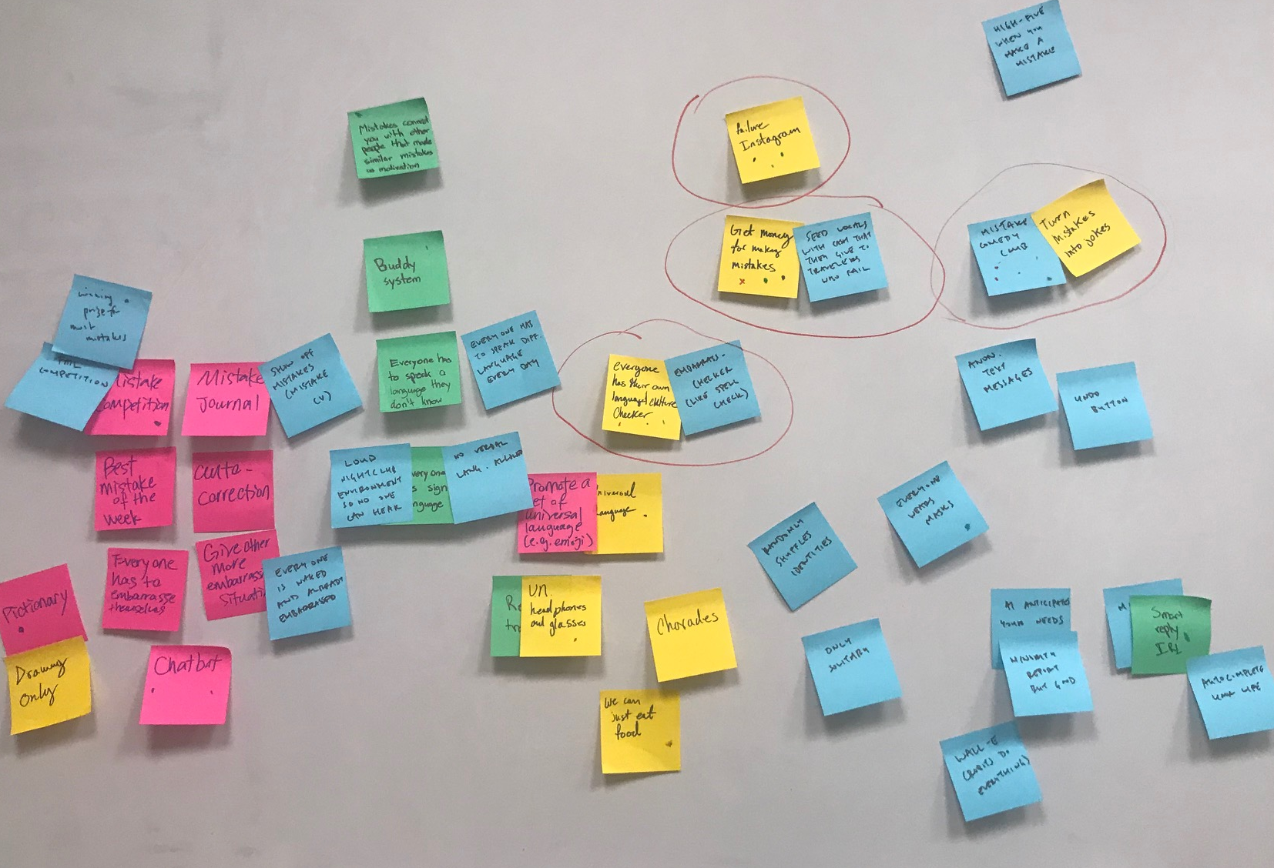
Top Three
Solutions
Mistake Comedy Club
Cultural Checker
Immersive Practice

Slide 10
Experience Prototypes

Slide 11
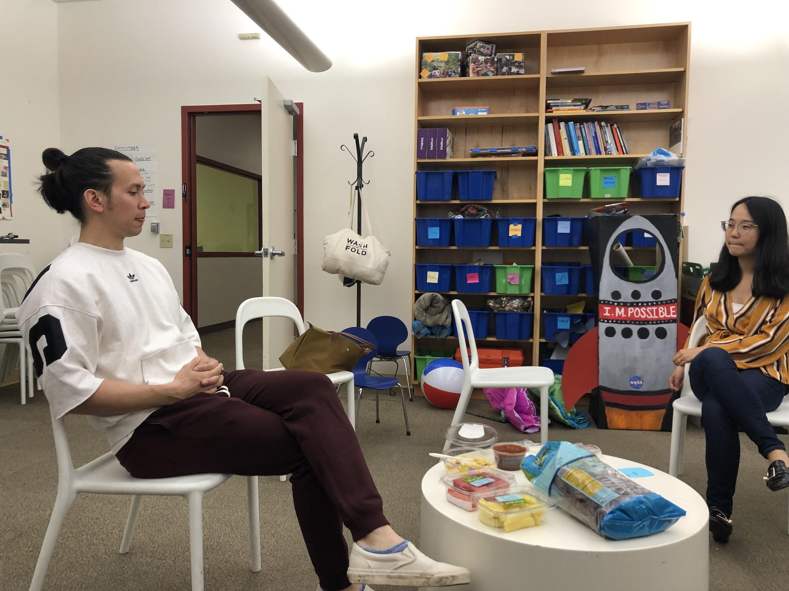
Mistake Comedy Club
Notes:
Mistake Comedy Club
Recruited Participants 1: Current MA student; native Chinese speaker
Recruited Participants 2: Visiting scholar; native Chinese speaker

Slide 12


Mistake Comedy Club
Goal: Change the perception of making a mistake
Assumption: People are more likely to share after seeing other stories
Observed: What we expected!
Assumption: User stories are based on emotional similarity of other stories
Observed: User stories are based on contextual similarity of other stories
Notes:
Mistake Comedy Club
Recruited Participants 1: Current MA student; native Chinese speaker
Recruited Participants 2: Visiting scholar; native Chinese speaker
How did you feel when you’re telling your story?
“I think it’s funny because it’s after the fact … the crazier it is, the better a story it is”
“As long as I live through it, everything is a positive experience (approach for mistakes in general)”

Slide 13
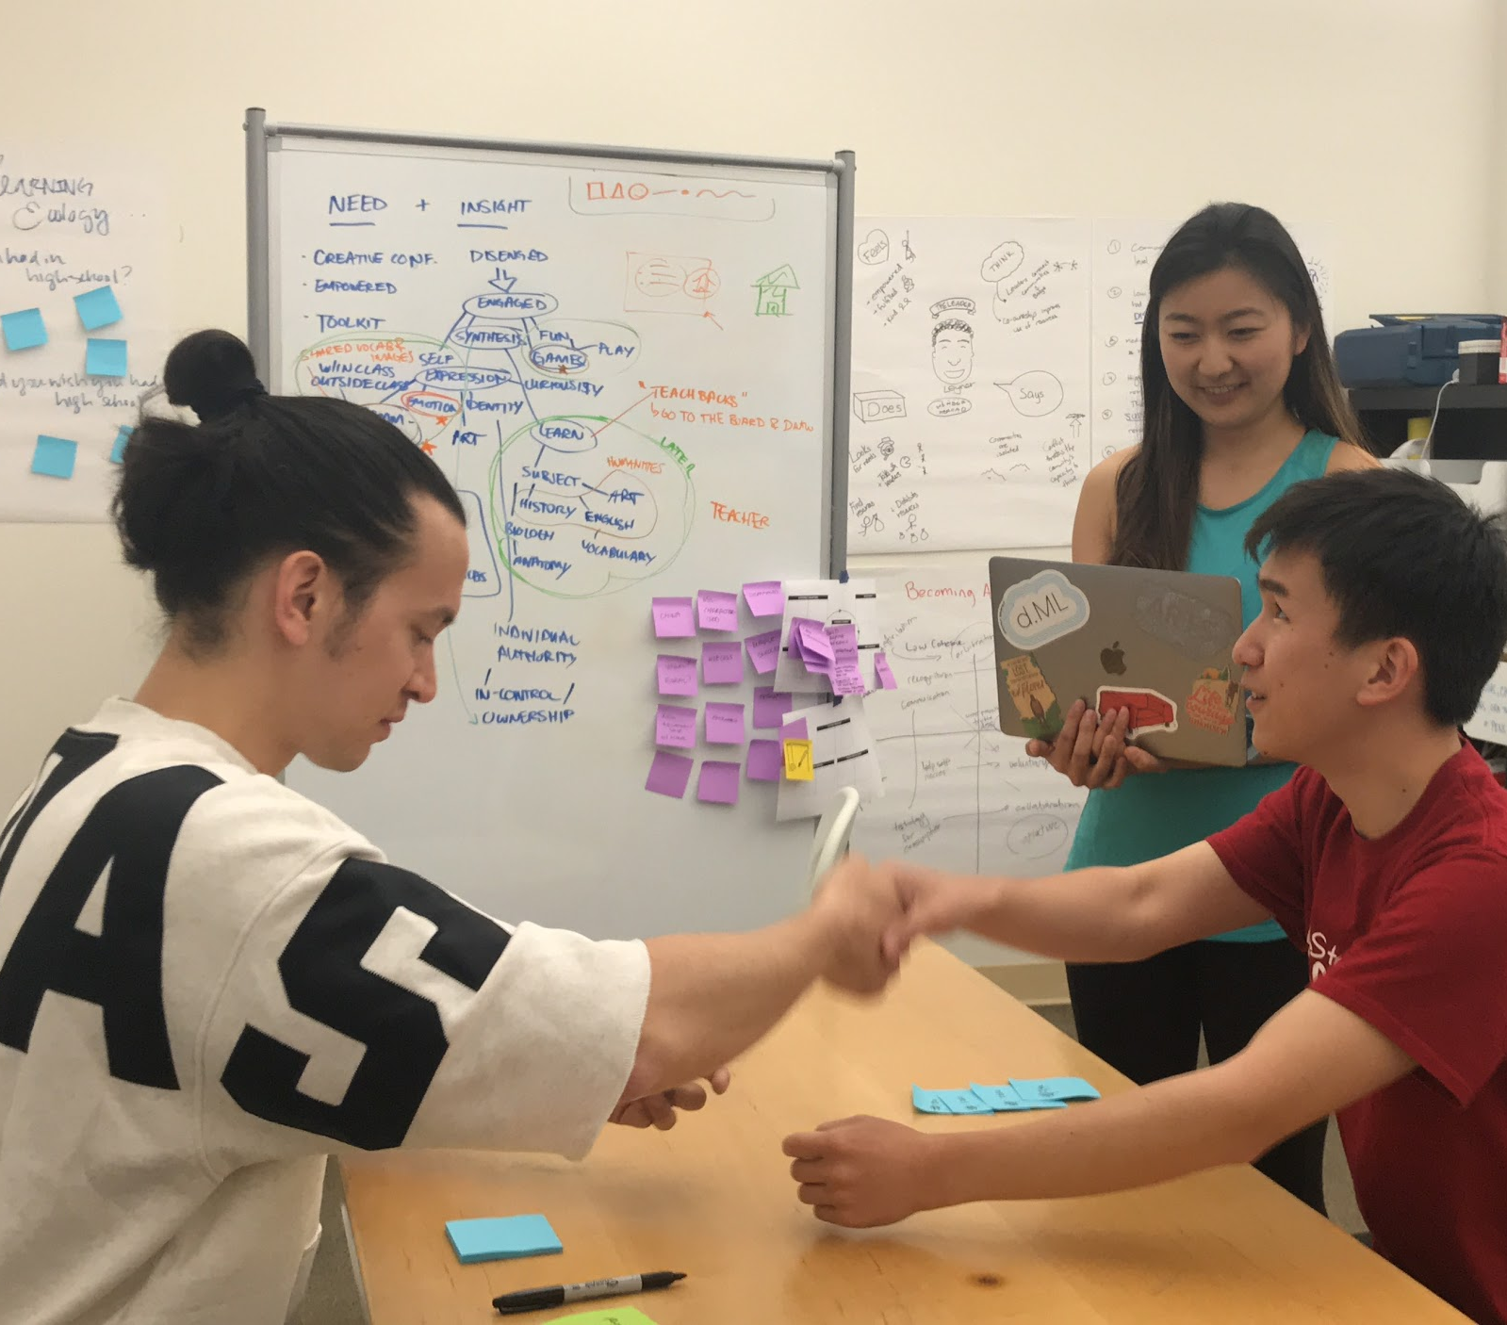
Cultural Checker
Notes:
Cultural Checker
Recruited Participants 1: Current MA student; native Chinese speaker with multiple international travel experience
Recruited Participants 2: Current MA student; native English speaker with international travel experience
Experience Prototype: we simulated a travel experience through role-play
Process - simulate experience through role-play
An actor that acts as an intelligent system that gives cultural checks upon request
One actor as the local in the imaginary culture; interact with the user
Two observers
the user tells the system what they plan to do, and the system gives them the checkers, i.e., a list of Dos and Don’ts
The users check before saying and do certain things
The users can also go back to the system anytime to check if what they want to say or do is appropriate
The actor needs to improvise based on the interactions with the user with the goal to probe users needs in a foreign culture and if they find the cultural checks useful
Artifacts: passport, money made out of post-its; Chairs to simulate taxi ride
Script:
Just landed in Chailand, need to take a taxi to the hotel and check in. Interact with taxi driver and interact with hotel receptionist.
Unspoken rules:
When handling money or passing over anything, must pass left hand to left hand while holding hands right hand to right hand
Smiling at strangers is very rude
Looking at strangers is very rude
It’s rude to talk to a taxi driver, just sit in silence and look out the window
When flagging a taxi, use two hands and “pull upwards”
Always tip around 10% for everything, but if you tip more than that it means you think the service was really bad and you’re suggesting they use the money to sustain themselves after quitting the job
When you give money, you have to ask for how much change you want or else it’s just assumed that you’re tipping the remainder

Slide 14
Cultural Checker
Goal: Avoid embarrassments from violating cultural norms through the use of a cultural checker
Assumption: Not knowing unspoken rules can be a source of embarrassment and a cultural checker can be helpful
Notes:
If language is not a problem, we want to test if not knowing cultural norms can be a source of embarrassment
We wanted to test our assumption that

Slide 15
This is like the most painful thing while traveling abroad… there are all these cultural traditions, norms that people don’t talk about. They just assume that you know things. And if you don’t, it is just embarrassing. Nobody is gonna tell you … like … everything
Notes:
Our assumption is validated by both participant. Here’s a quote from one of them.

Slide 16
Cultural Checker
Interesting Observations:
Asked a lot of questions upfront, as well as between interactions
Asked about online reservation and tried to confirm calculated amount of tips with the checker
proactively follow the local norms once they knew about it.
Users would like to know the why behind the customs
Notes:
If language is not a problem, we want to test if not knowing cultural norms can be a source of embarrassment

Slide 17
Cultural Checker
Insights
Users wanted to have this tool:
“I need this thing”
“I would be very happy to have it”
Both suggested they probably would have done some research before going to a foreign country,
Notes:
We tested with 2 people;
More specifically, we found that

Slide 18
Cultural Checker
Insights
… but having a checker is different from just reading online articles
“just-in-time feedback”
Give a whole debrief about a specific situation before initiating an interaction
Reminders
“There are probably cultural things that I’m used to that I might revert back to do it if I’m not reminded about it”
Notes:
More specifically, we found that

Slide 19
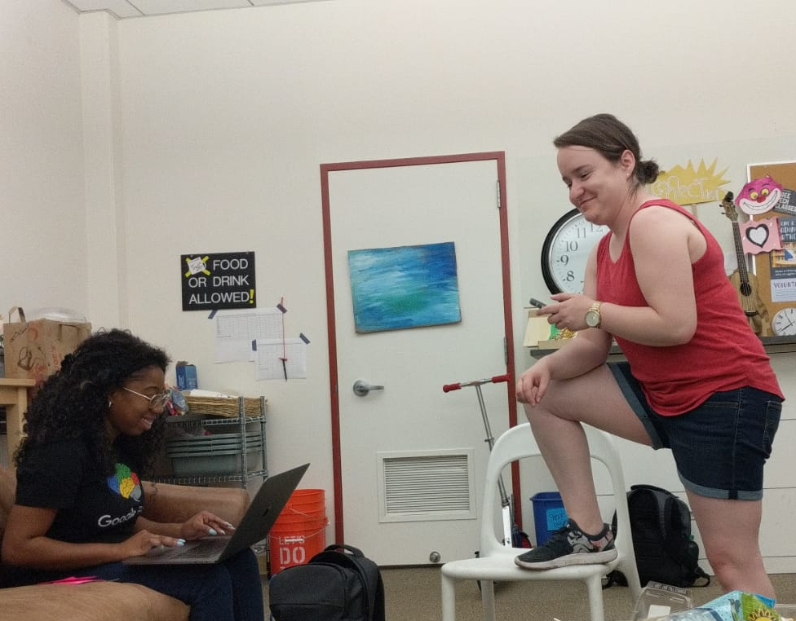
Immersive Practice
Notes:
We asked learners to act out a scene from a given prompt, in order to successfully accomplish a task. Instructions were given in their native language, but all acting had to be done in the language they were learning
Virtual Language Immersion:
Recruited Participants 1: Visiting scholar; native Chinese speaker
Recruited Participants 2: Current MA student; native English speaker, Spanish language learner (studied in high school and college) with international travel experience

Slide 20
Immersive Practice
Goal: Build confidence, motivation and practical language skills through goal oriented virtual scenarios
Assumption: Practicing non-typical situations will challenge learners in unique ways.
Observed: Non-typical situations quickly uncover important gaps in language skills and Vocab

Slide 21

Immersive Practice
Insights
In the real world Google translate isn’t enough often the direct translations don’t make sense in the context, and some translations (like names of snakes) are unknown. Meta communication strategies were needed.
Participants responded to real time feedback
Repeating what they said with corrected grammar was a useful tool
We thought people might be shy or embarrassed. Turns out, NOT at all!
Gestures are important
Both participants used their hands and full body to act out things

Slide 22
Going to the mechanic in this new country made me feel like a baby… it’s like what they say I assume it’s right. If they are asking more money I would accept assuming it is correct

Slide 23
Thanks

